Slide 1
LITR 640
Day 5

Slide 2

Adapting Assessments for English Language Learners

Slide 3
Notes:
Why?

Slide 4
How do I differentiate my lessons?
Make a connection!
Answer these questions:
What do you want them
to learn?
What vocabulary do
they need to know?
What proficiency level are they?
Notes:
This is review.

Slide 5
What do you want them to learn?
Look at your final product/assessment.
List three or four main points or tasks that will be required.

Slide 6
What vocabulary do they need to know?
Make a vocabulary list.
Decide what vocabulary might be difficult for ESL students.
Include content area vocabulary as well as directions.

Slide 7
What proficiency level are they?
Know the LEP level of your students. When in doubt, ask your ESL teacher.
Check to see what types of activities students will be capable of accomplishing at various LEP levels.
Notes:
Can-Do Descriptors

Slide 8
So how do I really do it?
Adapt by matching the students’ abilities with your learning goals for them.
Check whether your textbooks have different versions of tests already created for you.
Adapting your own material might be as easy as offering a vocabulary list, or letting LEP students use notes.
*Adapted from a presentation by Jenny Noble-Kuchera, Catherine Marchese, and Julia Copeland (2006).

Slide 9
What about tests and other assessments?
Keep in mind that the content of the material is important. Progress should be assessed over time. Grade what students can do instead of what they can’t do.
Be patient with them and yourself!
*Adapted from a presentation by Jenny Noble-Kuchera, Catherine Marchese, and Julia Copeland (2006).
Notes:
Share conversation from Luhr: If students are showing understanding of same content, but in a different way, then they should get the same grade as any other student.

Slide 10
Language and Content-Area Assessment
Understanding of academic subjects must be assessed in a way that allows students to demonstrate their knowledge somewhat independently of their English fluency.
Scaffolding assessment
  Allows students various ways to demonstrate knowledge: projects, graphic organizers, labeled tables or graphs completed by students, K-W-L, content area logs, reading response logs, portfolios
  Again, must take language proficiency levels into consideration

Slide 11
Language and Content-Area Assessment
2. Differentiated scoring
  Score students separately on content knowledge and on language
  Integrates assessment of language arts in other content areas
LANGUAGE Sentence Structure Key Vocabulary | CONTENT Understanding of Key Concepts Accuracy of Answers Demonstration of Process Used to Derive Answer

Slide 12

EXAMPLE
Test/grade only the specific skill or concept – don’t test language
Notes:
Christine Scheid

Slide 13
Language and Content-Area Assessment
3. Visible or explicit criteria for scoring
  Familiarize students with scoring criteria before assessment is given
  Involve students in creating scoring criteria
  Students should practice applying these criteria to actual examples to become familiar with criteria
  Source: Eastern Stream Center on Resources and Training (ESCORT).( 2003). Help! They don’t speak English Starter Kit for Primary Teachers.
Notes:
Example bullet 3: When whole class scores open-response items!

Slide 14
What are some strategies for adapting assessments?
Reduce response materials for content area testing
Provide a version of the test with simplified language
Simplify directions
Read test questions aloud
Supply word banks for tests
Provide matching activities
Extend time to complete the tests
Allow the student to respond orally rather than in written form
Use portfolios to authentically assess student progress
http://www.everythingesl.net/inservices/judith2.php

Slide 15
What if I have to differentiate “on the fly”?
Use a highlighter/ post-it to focus on key concepts.
Write “top three” vocabulary words on the board.
Draw, gesture, or mime the concepts while you teach.
Use a “Sharpie” to simplify/ shorten readings/ questions that are not-as-essential.
*Adapted from a presentation by Jenny Noble-Kuchera, Catherine Marchese, and Julia Copeland (2006).

Slide 16
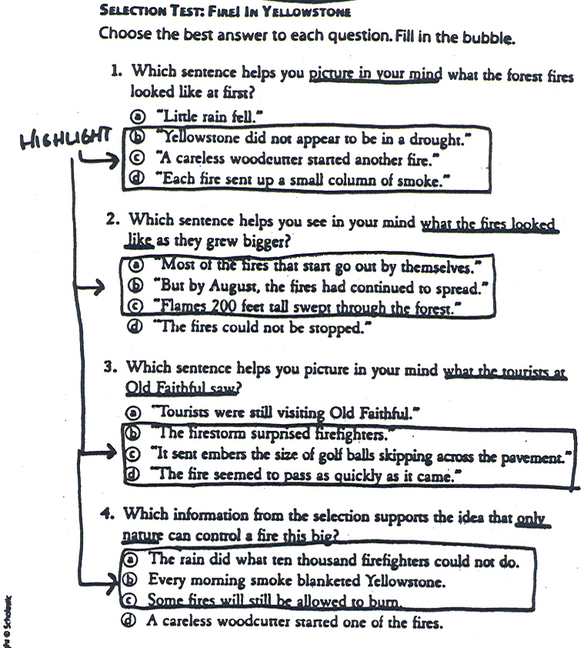
Highlight options (with reduced choices)
Underline clues
Notes:
Christine Scheid

Slide 17
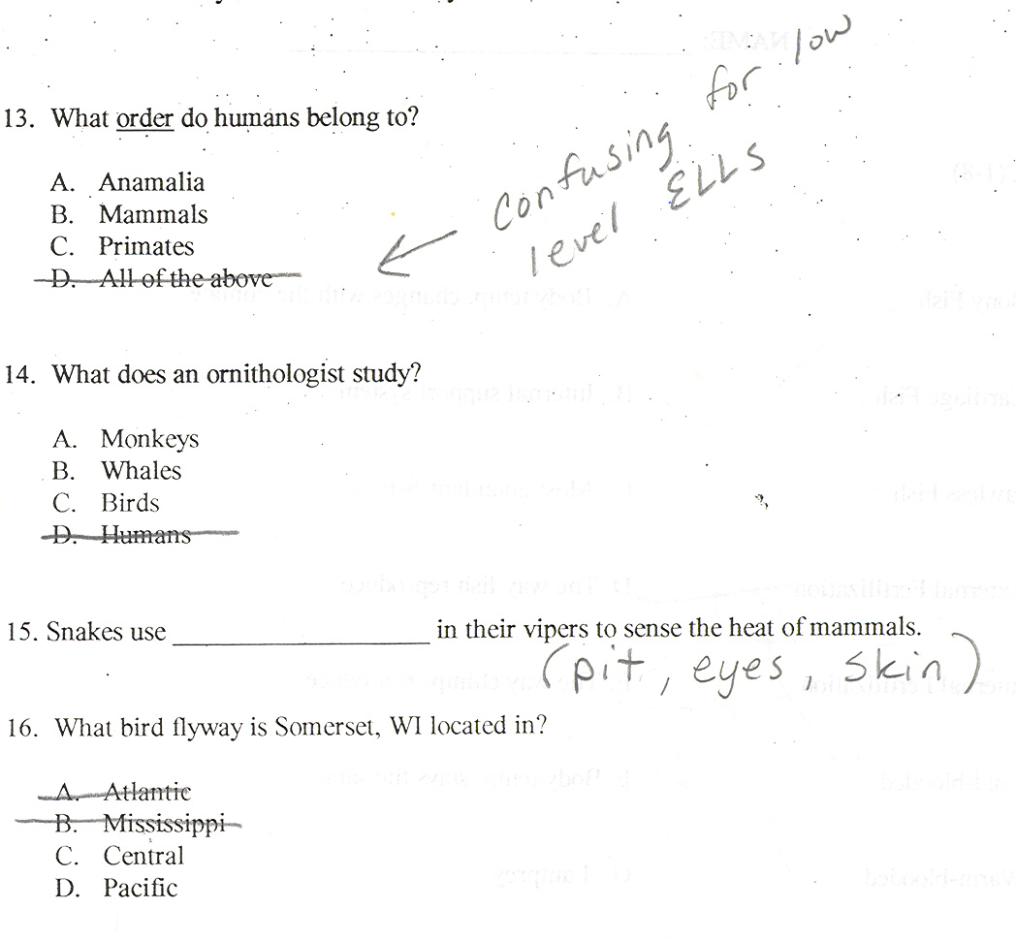
Eliminate choices
Notes:
Christine Scheid

Slide 18
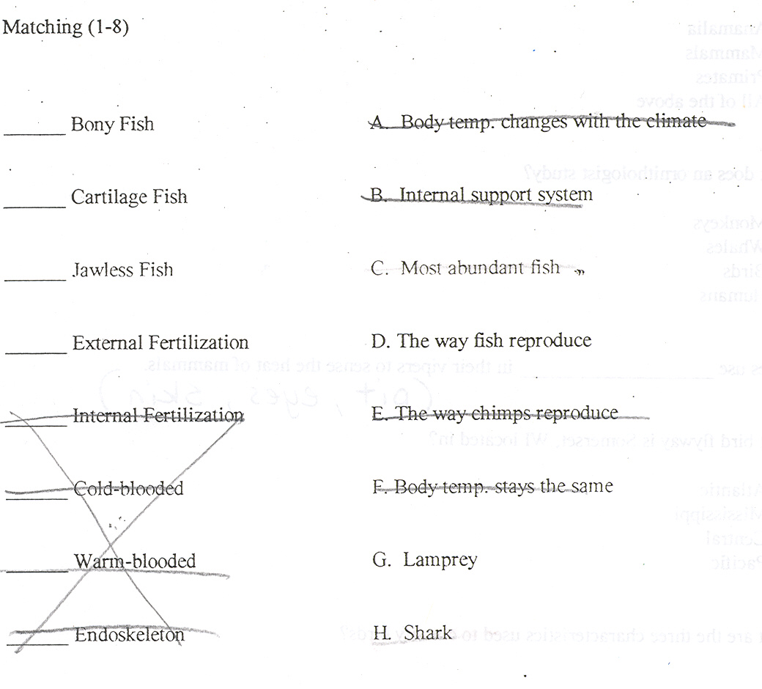
Shorten length
Notes:
Christine Scheid

Slide 19
Additional Examples

Slide 20
Your 6th grade Science test has 15 matching questions, 5 short-answer questions, and 10 fill-in-the-blank.

Slide 21
You could…
For a level 1 student you could write down the 5 most important vocabulary words/ concepts, and have them illustrate each word/ concept.
For a level 3 student you could: give a word bank for the fill-in-the-blank questions, ask him/her to pick 3 of the 5 short-answer questions, and underline the critical vocabulary in each of the matching questions.

Slide 22
Reader
Give tests orally
  Arrange for a bilingual student/parent to interpret oral test
Notes:
Or, read the test in English using simplified language.

Slide 23
With a reader and simplified language
Notes:
Does this student understand the content? Dean Smith.

Slide 24
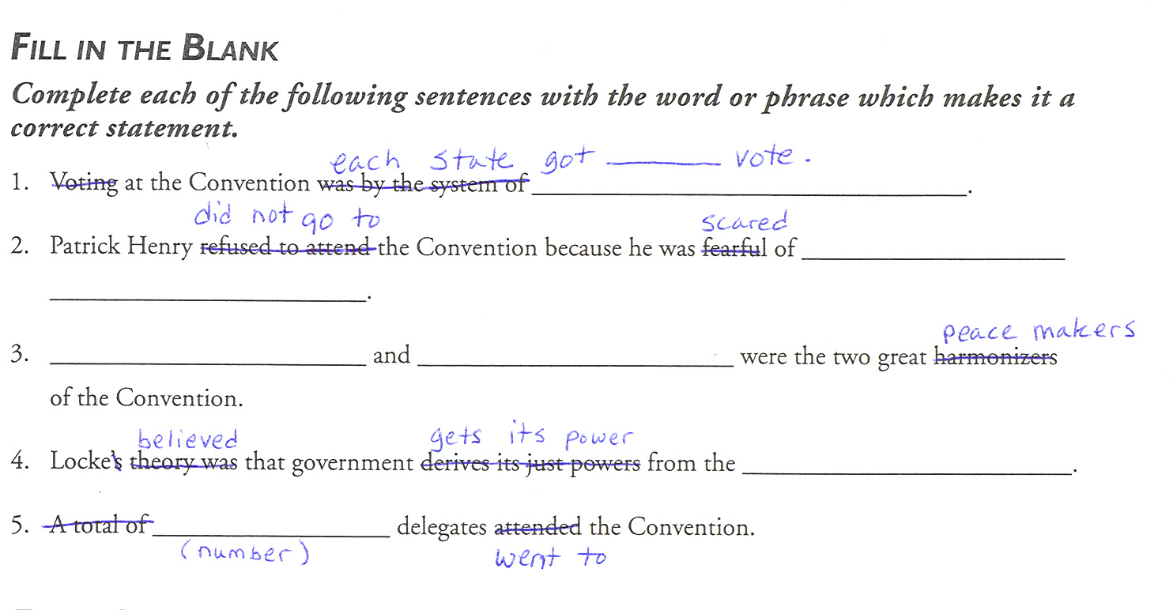
TESTS
Simplify the language you use in the directions and test questions.
  Eliminate words
  Give straightforward commands
Notes:
Christine Scheid

Slide 25
Notes:
Holly Terry adapted this from a fill-in-the-blank. She added pictures. All kids got 0 first time. All got 100 when retook.

Slide 26
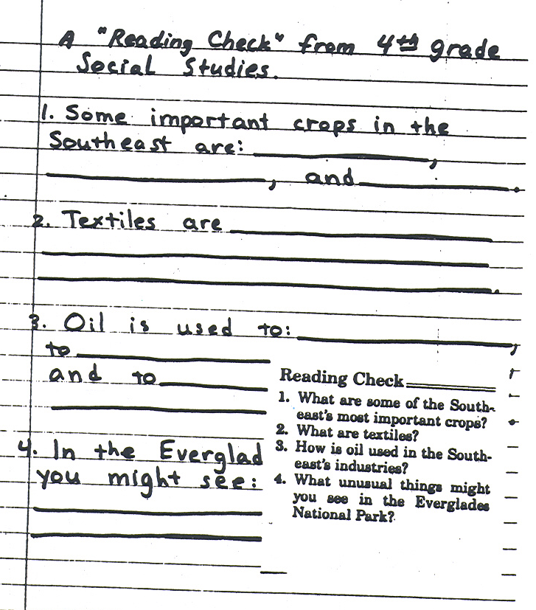
TESTS
Offer writing prompts or cloze versions of essays.
Notes:
Christine Scheid

Slide 27
TESTS
Encourage use of the index and pictures in the book.
Put page #s next to the question.

Slide 28
TESTS
It’s not a crime to…
    Give clues.
    Recast the question to allow for multiple choice or yes/no answers.
    Divide word bank portions into 2 smaller sections.
    Tailor the test to your student’s acquisition level.

Slide 29
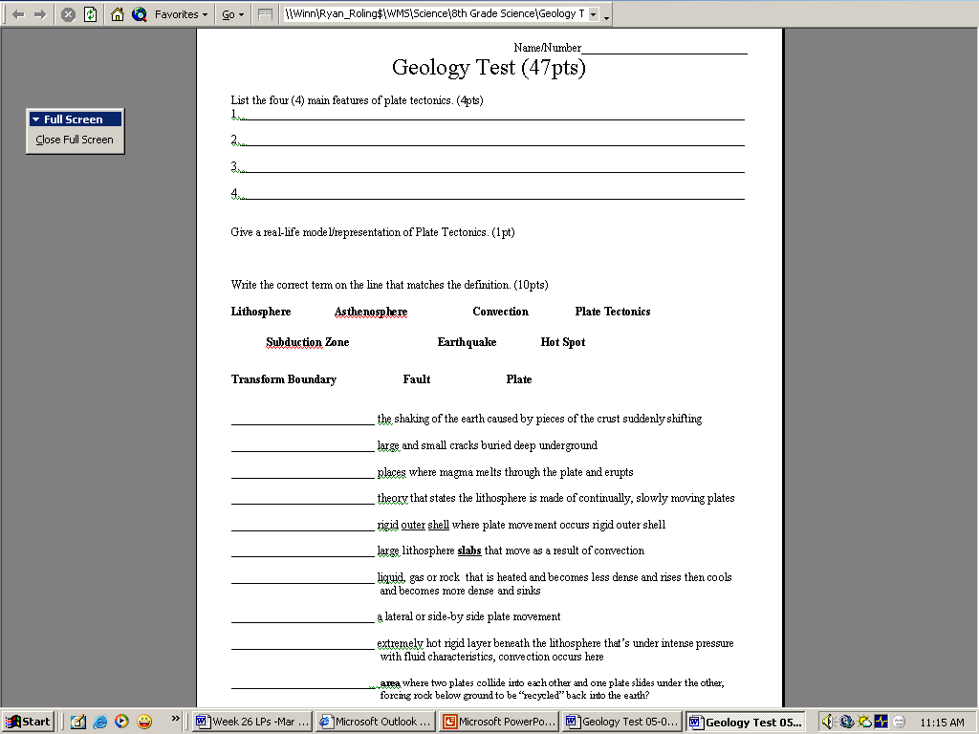
Notes:
Christine Scheid

Slide 30
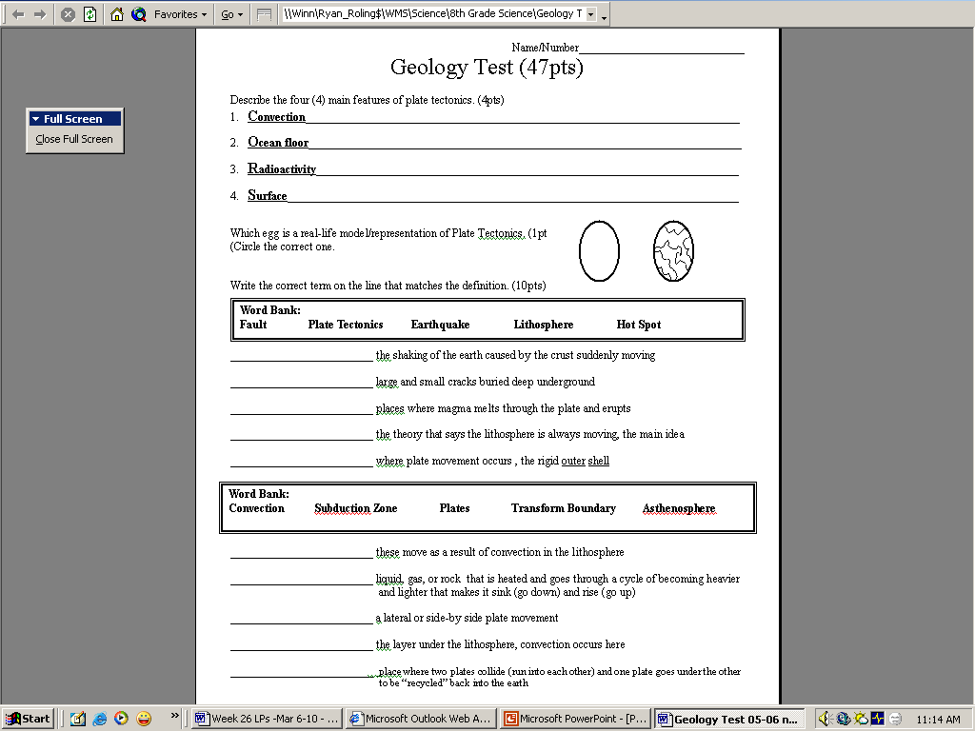
Notes:
Christine Scheid

Slide 31
What about grading?

Slide 32
Notes:
Accommodations vs. Modifications

Slide 33

Learning Check
AQC9LRIV

