Slide 1
SIOP
One framework for helping teachers implement instructional and assessment accommodations and build academic language is Sheltered English Observation Protocol (SIOP).
SIOP is one model of sheltered instruction that is the most researched, developed, and explicated of the sheltered instruction variations (Herrera & Murry p. 283).

Slide 2
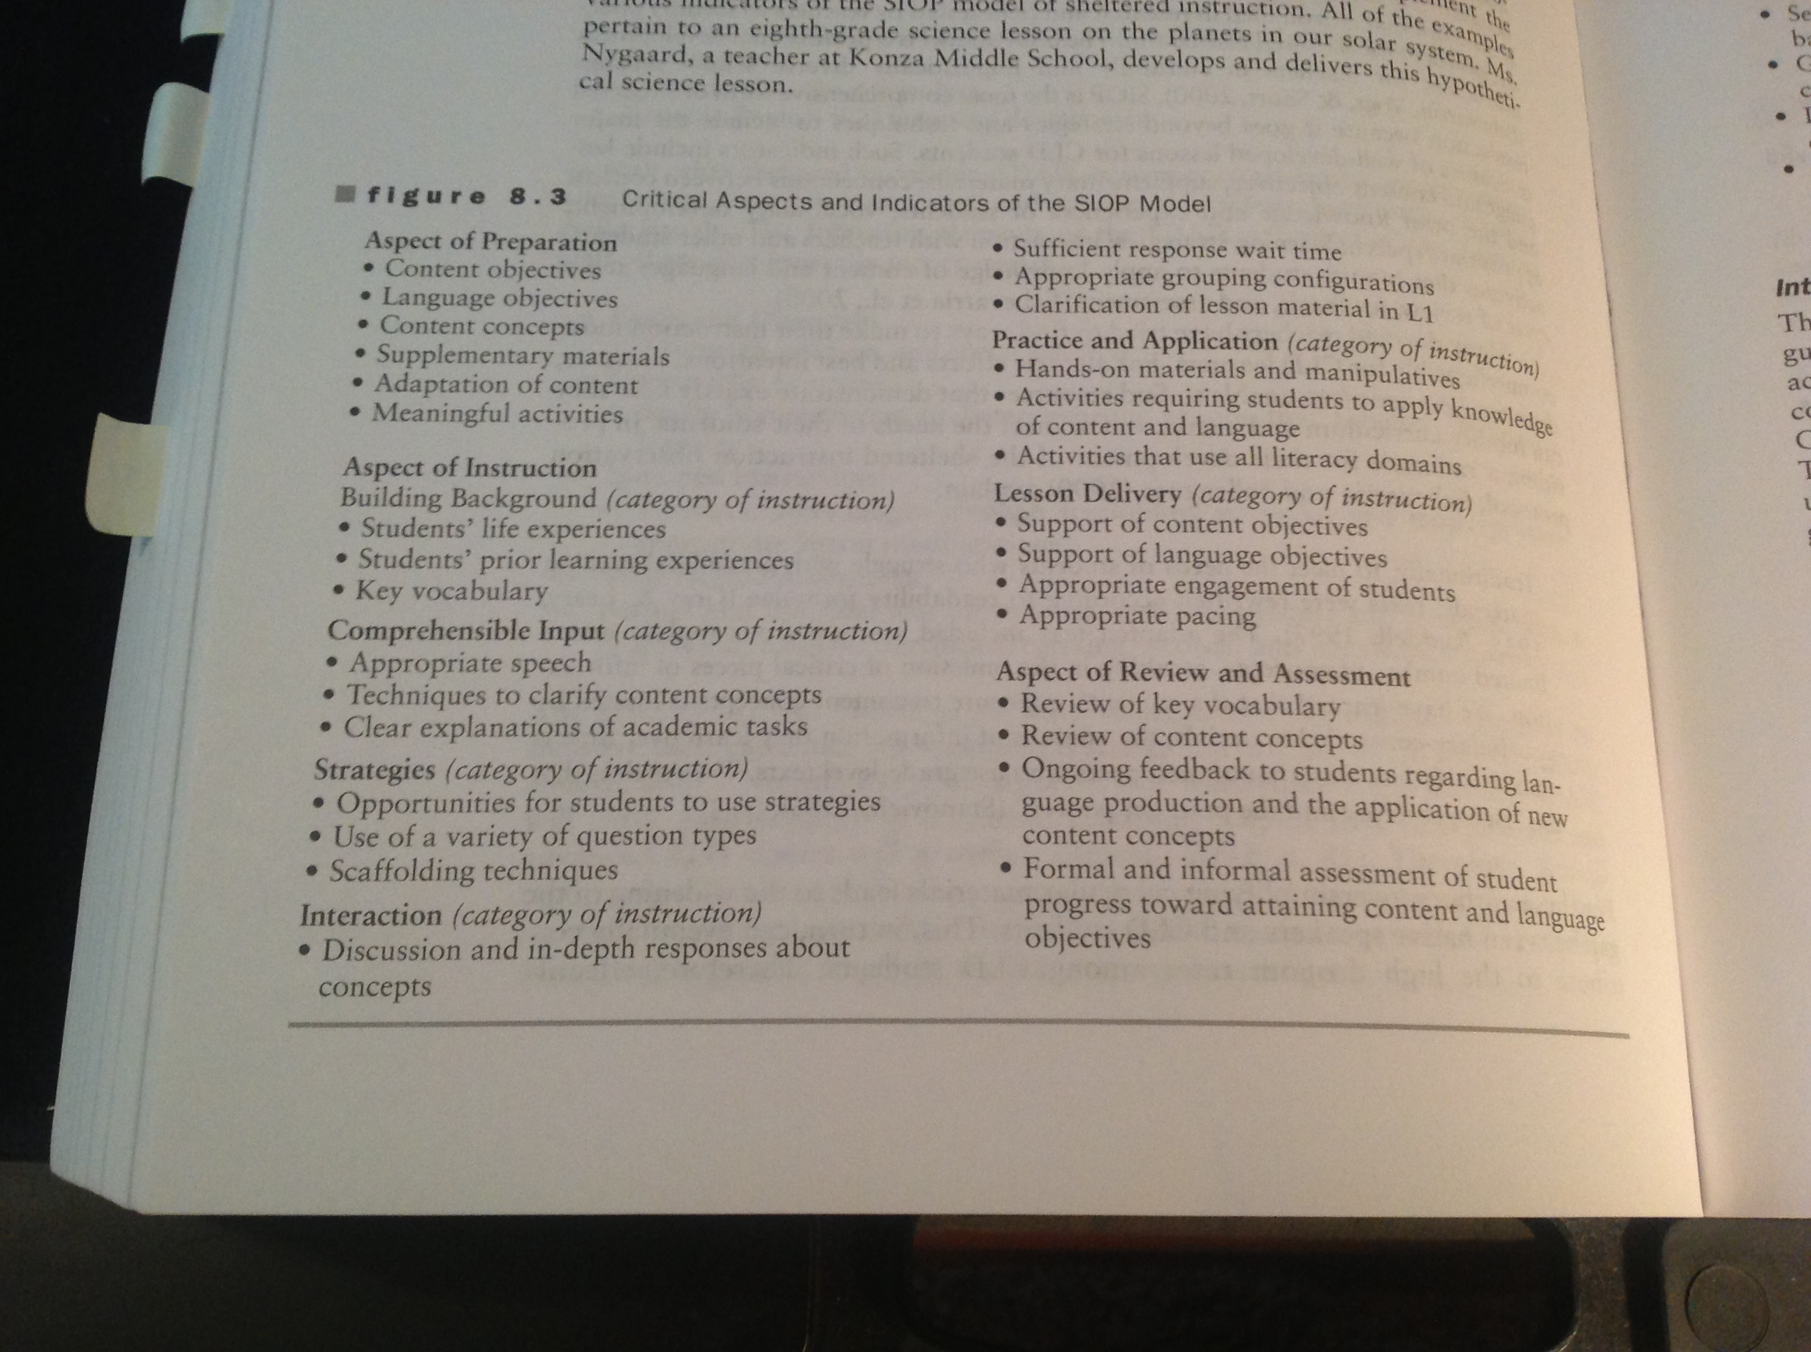
SIOP
Critical Aspects and Indicators (Herrera & Murry p. 284)

Slide 3
What is SIOP?
S = Sheltered
I = Instructional
O = Observation
P = Protocol
SIOP was started by Echevarria & Short to assist teachers in improving their adaptations for ELs in L2 taught classes.

Slide 4
What is SIOP?
Sheltered instruction is
One of the instructional models that uses English only
Not a set of additional or replacement instructional techniques for the content area classroom with native speakers
An instructional form to extend time ELs have for language support services while providing content area information required for graduation
Wide-spread and exists in many variations

Slide 5
What is SIOP?
SIOP includes specific lesson planning and delivery suggestions and teacher observation protocols
Sheltered instruction includes strategies such as
Cooperative learning,
Explicit, targeted vocabulary development
Slower speech with clear enunciation and fewer idiomatic expressions
Visuals, demonstrations and hands-on learning
Text adaptations
Homework adaptations
Supplementary materials

Slide 6
What does a SIOP lesson plan look like?
Examples on Weebly
Center for Applied Linguistics
Notes:
Back to Weebly

