Slide 1
Program Models in Kentucky
English as a Second Language (ESL)
  English as a New Language (ENL)
  English to Speakers of Other Languages (ESOL)
ESL models, although less effective with CLD students than certain bilingual education programs (e.g. two-way bilingual), often arise as a result of complicating variables including geographic and sociopolitical variables (Herrera & Murry, p. 118).
  Lack of qualified bilingual teachers
  Lack of bilingual education endorsement programs
  Number of different languages spoken by students
  Lack of public support due to cost, English proficiency outcomes, beliefs about language
Notes:
The essence of Lau was codified into federal law though the Equal Educational Opportunities Act of 1974 (EEOA), soon after the case was decided. Section 1703(f) of this act declares: "No state shall deny educational opportunities to an individual on account of his or her race, color, sex, or national origin by … (f) the failure of an educational agency to take appropriate action to overcome language barriers that impede equal participation by its students in its instructional programs."
At the time of its passage, this section of the EEOA was viewed as a declaration of the legal right for students to receive a bilingual education, under the assumption that this is what Lau essentially mandated (Del Valle, 2003). Although other legal actions have since made it clear that the Supreme Court never did mandate bilingual education, the EEOA remains in effect and several subsequent lawsuits have been based on this important legislation. (Colorin Colorado)

Slide 2
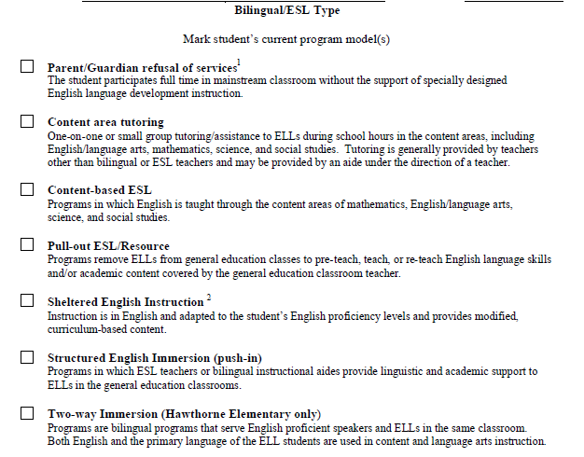
ESL Program Models
Notes:
Middle and High School uses an ESL class period. This counts as an English/Language Arts credit. They mark Content Area Tutoring for this.

Slide 3

Learning Check
Room: AQC9LRIV

