Slide 1
Program Services Plan
All LEP students require a PSP (Title III, Sec 3302, No Child Left Behind Act of 2001)
A copy of this document should be kept in the cumulative folder
Accommodations must be documented and ongoing for inclusion on KPREP
PSP
Notes:
ESL Teacher has a copy.
Classroom teacher(s) should have a copy.
A copy of this document should be kept in the cumulative folder
Accommodations must be documented and ongoing for inclusion on KPREP

Slide 2
JCPS Program Services Plan (PSP)
Each newly enrolled JCPS LEP student has an Initial PSP which is completed by the ESL Intake Center.
A Current Year PSP is completed by the school each year.
The Initial PSP includes Student Demographic Information, Academic History, and W-APT Scores
The ESL Office keeps both a paper and electronic copy of the initial PSP.
The initial PSP is also emailed and ponied to the receiving school
Both newly enrolled and continuing LEP students must have a Current PSP completed within 30 days of enrollment or the beginning of the school year (10/1/14)
The Current Year PSP includes information on the student’s LEP Service Type(s) as well as accommodation information.

Slide 3
The Program Services Plan (PSP)
PSPs meet a requirement of No Child Left Behind (NCLB) Title III and KY state regulation (703 KAR 5:070).
Initial PSP (Spanish)
Initial PSP (Arabic ) Completed by the ESL Intake Center
  Includes demographic information
  Academic history
  Immigrant or refugee status
  W-APT scores
Notes:
A sample initial PSP has been inserted as a link. Click and review the information received by the ESL team, administrators, and ESL RT.
All of this information is entered into CASCADE on the LEP tab by the ESL Office. Every teacher with Infinite Campus rights can access this information on his or her students.
Choose one PSP and locate the information in the bullets.

Slide 4
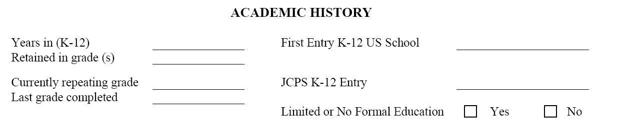
Page 2
Limited or No Formal Education =
  Enrollment in a school with calendar less than 6 months/year
  Enrollment in a school that meets for less than 4 hours/day, 5 days/week
  No access to or attendance in school for 2 or more continuous years

Slide 5
The Program Services Plan (PSP)
Every year the PSP is updated for all students who qualify for ESL services.
PSP for all English Language Learners
Notes:
The ESL team completes these for their students.
We will talk more about accommodations later.

Slide 6
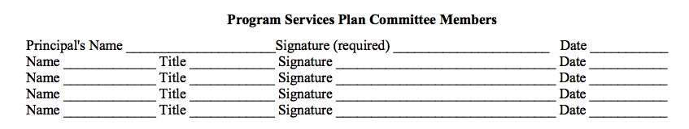
Notes:
P 10 of Inclusion Reg
Which landmark case requires that a committee review and approve of PSP? (Lau v Nichols—Lau Plan)

Slide 7
You can access PSP information
A hard copy of the completed PSP is signed and placed in the student cumulative folder.
  Information from the PSP is added to Infinite Campus each year when the document is updated.
WIDA ACCESS Can Do Name Charts
Notes:
Show the teachers how to access the LEP tab if needed.
The ESL team will provide data on your students’ level of English proficiency in each domain of listening, speaking, reading, writing.
The Can Do Name-Charts (HANDOUT) can be used in conjunction with the Levels of English Proficiency in All Domains document. You can write the students names in each domain to get more detailed information about what can be expected of students in the form of output. You will learn more about the WIDA ACCESS Test in a few minutes.

Slide 8
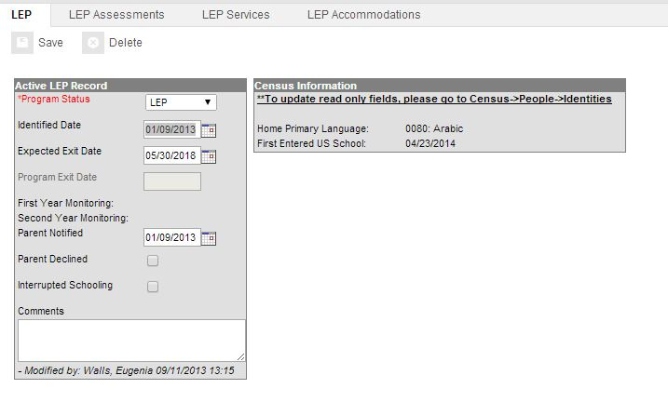
Infinite Campus LEP Tab
Path: Student Information→ Program Participation→ LEP
Notes:
Amie Jobe as example.
The information on the LEP Services and LEP Accommodations tab is entered into IC each year from the updated PSP. It is important that all teachers of LEP students have access to the LEP tab in IC so they can review the types of services and accommodations that are available to the student. To view the individual LEP tab for each student, type in the student’s name in the IC Index, and follow the path Student Information, Program Participation, LEP. You will then be able to click on the four LEP tabs. (Demonstrate)

Slide 9
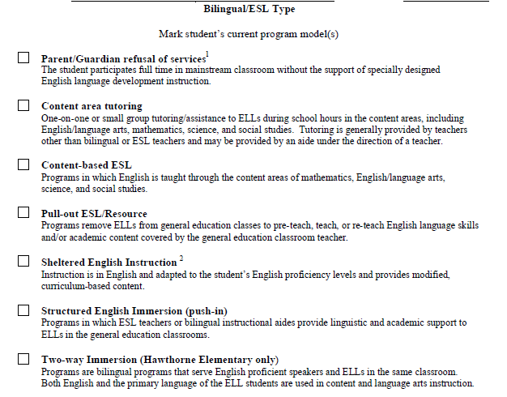
Page 4

Slide 10
For LEP students who have an ESL program waiver

Slide 11
Instructional Accommodations
Help English language learners access the content being measured
Help with comprehension
Reduce the language load
Allow more accurate assessment of content knowledge by reducing the effects of the language barrier
Notes:
The accommodations are selected with careful attention to these factors. This is why it’s not “just good teaching.” We have to know the process of language acquisition and where our students are in that process in each domain.

Slide 12
Instructional Accommodations
Code your instructional accommodations.
  Look at page 2 of the PSP. Some of the accommodations are used in instruction and on assessments. Some are only used instructionally.
  Code the instructional accommodations in the following way
√= I know what this mean.
?= I don’t know what this means.
*= I think I know what it means. I’m not sure.
Notes:
Teach and model meta cognitive is in CALLA article!! P.241-242.
We usually spend a lot of time making sure we understand assessment accommodations. We have the Inclusion of Special Populations Regulation and Code of Ethics documents and training from KDE. But what about instructional accommodations?
(HANDOUT page 2 of PSP)
All accommodations provided on assessments must be used routinely in the classroom. Some instructional accommodations are not also available on assessments. Instructional accommodations are research-based effective practices that benefit many students. But for ELLs they are essential to the students’ participation in the classroom.
All listed accommodations are not necessarily used in each lesson.
Please code your accommodations using the symbols above. This is a formative assessment for us to know how we can support you best.

Slide 13
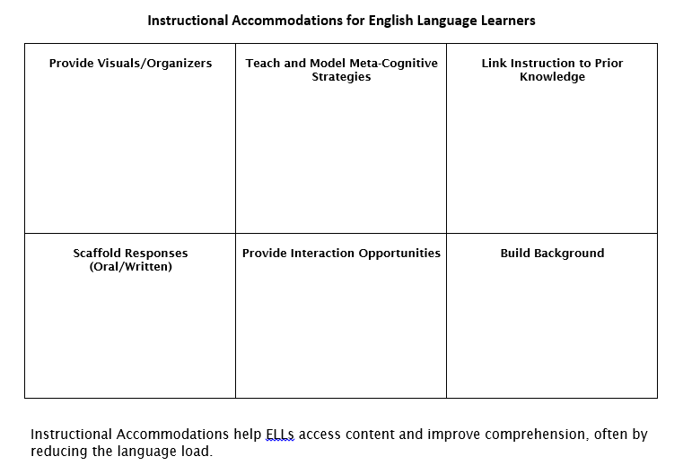
Notes:
(HANDOUT) These six instructional accommodations provide a great deal of support to ELLs and other low oral language students. We will focus on these in the next few slides. These are reflected in the tabs of the LiveBinder we have been reviewing.

Slide 14
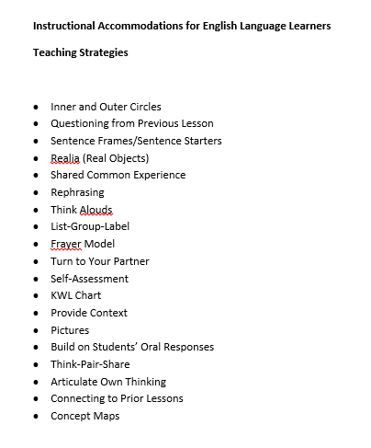
Notes:
(HANDOUT) Review this list of teaching strategies. Write each one in one of the boxes on the organizer (previous slide). Are there any strategies you are unfamiliar with? If so, ask a partner in your group. If you still don’t know, try googling or raise your hand.
If there are strategies you use that are not listed, please add them to your organizer (previous slide).
When you finish, compare your responses with someone at your table. What do you notice?

Slide 15
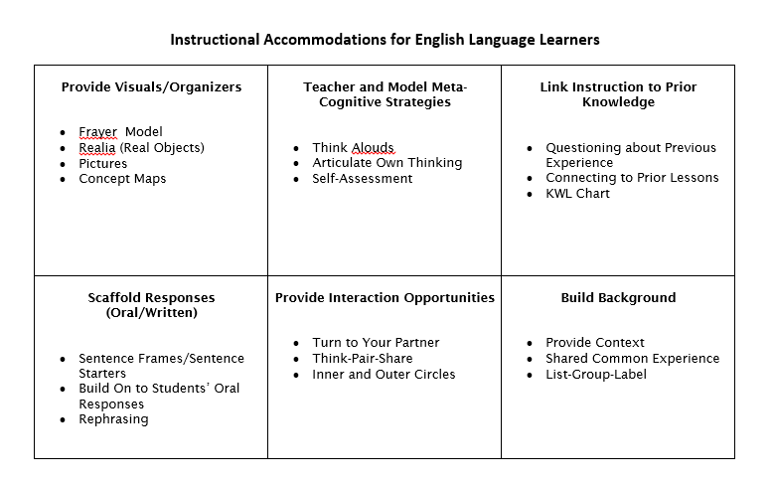
Notes:
Here are some common strategies that help teachers meet the needs of ELLs.
Would any of these have helped Moises? Why?

Slide 16
Group share
What do you notice?
Do you think any of these strategies would have helped Moises?
Why or why not?

