Slide 1
LITR 640
Class 1

Slide 2

Who are the students?
Notes:
Video is linked to pic. (4 min)

Slide 3

Facts about JCPS English language learners
Poll Everywhere Survey
Notes:
In one school there may be as many as 17 or more languages spoken. You must be the expert on making content comprehensible in English.

Slide 4
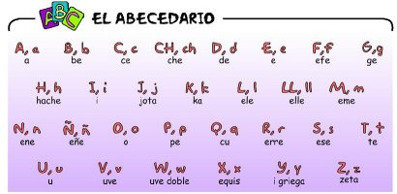
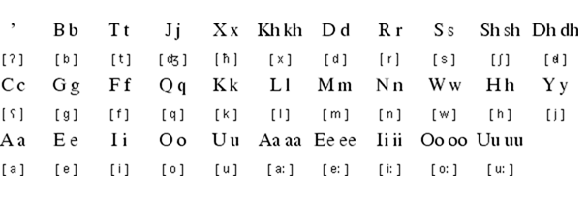
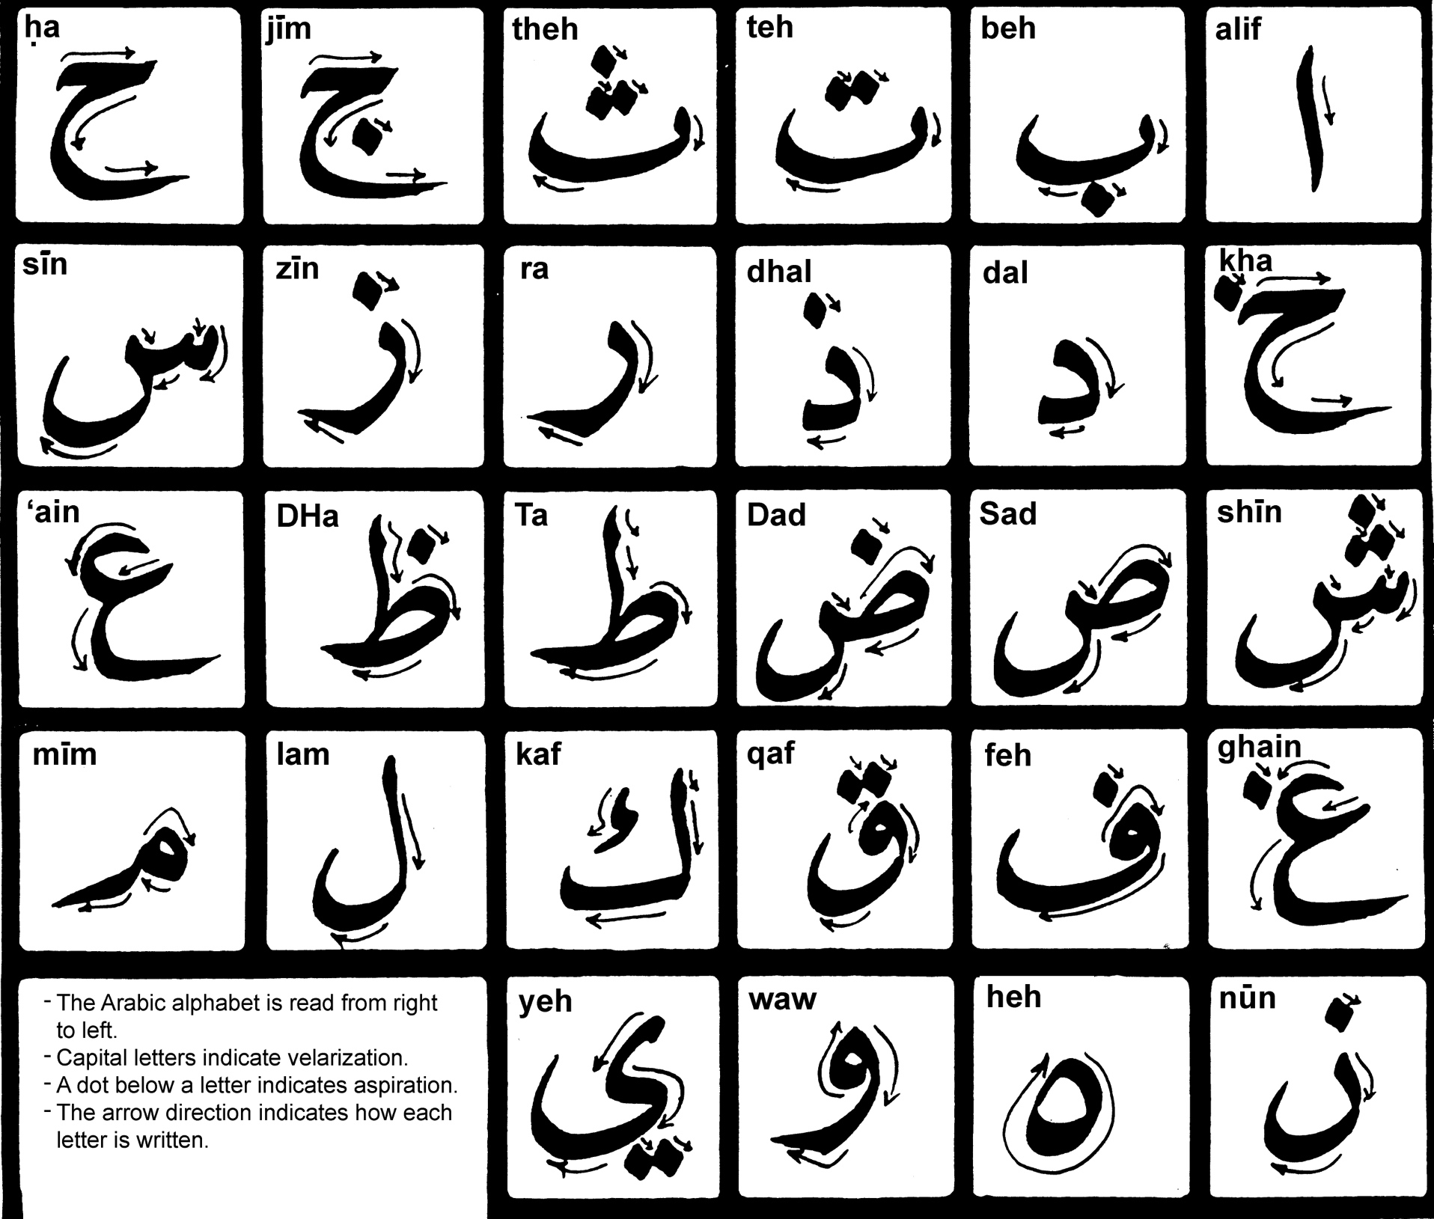
Did you know?
Spanish
Somali
Arabic
Notes:
Top 3 languages spoken by ESL students in JCPS.

Slide 5

Telegu

Slide 6
What’s the lingo?
While we strive to make language simple and clear for our English learners (ELs)…we are not that great at making it that way for teachers!
    Herrera & Murry p. 6
Common Acronyms from Bilingual and ESL Education
    Herrera & Murry pp. 8-9

Slide 7
How do we know who they are?
NELB
Enrollment Form
LEP
Test at Intake Center
ESL
Parent Permission

Slide 8
Identification Flowchart

Slide 9
Home Language Survey
Located on the JCPS Enrollment form
If the child was born outside the US, or the answer to one of the other 4 questions is something other than English, the child is considered NELB and referred to ESL Intake for W-APT assessment and registration
Notes:
HLS Q’s are:
What is the lg most frequently spoken at home?
Which lg did your child learn when he or she first began to talk?
What lg does your child most frequently speak at home?
What lg do you most frequently speak to your child?

Slide 10
W-APT (WIDA--ACCESS Placement Test)
Overall PL < 5.0
Student is not proficient, then Limited English Proficient (LEP)
Overall PL ≥ 5.0
Student is proficient, then Initially Fully English Proficient (IFEP)
Notes:
If asked, can show in IC
02:LEP
01:IFEP

Slide 11
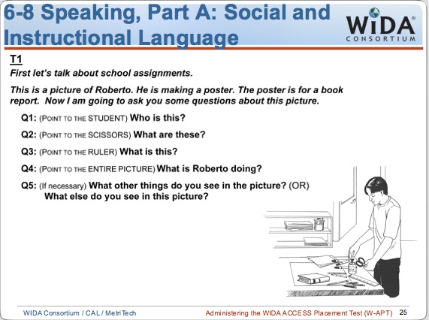

Slide 12
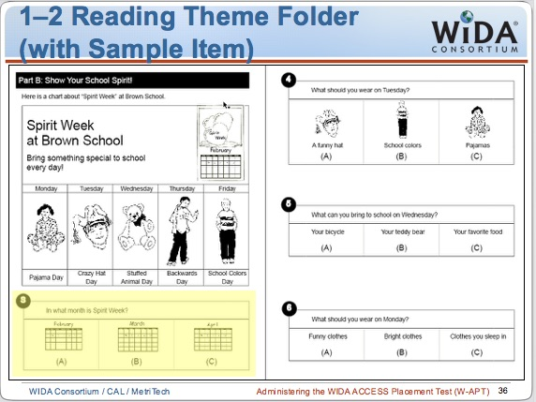

Slide 13
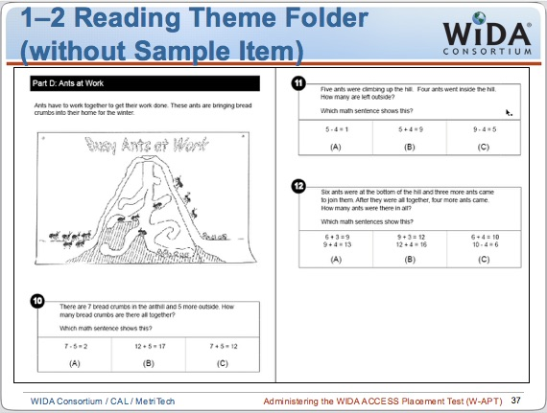

Slide 14
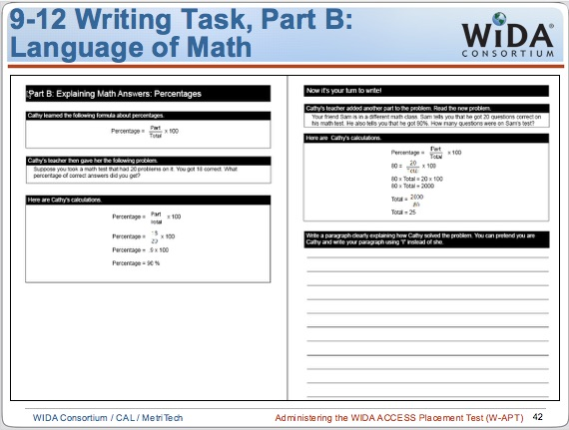

Slide 15
Accept/Waive ESL
Parents have the right to accept or waive ESL services
If they accept services, the student is LEP and ESL
Bilingual/ESL Type is indicated on their PSP
Student participates in annual ACCESS until Overall PL ≥ 5.0 AND Literacy PL ≥ 4.0
If they do not accept services, the student is LEP but not ESL
Bilingual/ESL Type is Parent/Guardian refusal on their PSP
Student participates in annual ACCESS until
Overall PL ≥ 5.0 AND Literacy PL ≥ 4.0

Slide 16
The JCPS ESL Intake Center

Slide 17
Who are the families we serve?
Immigrants
Move by choice and due to a promise of a better life.
The main reasons include better economic conditions, education, and family reasons.
They still have a choice to move back to their country at any time.
Refugees
Move out of a fear of persecution caused by war, violence, political instability, aggression or due to their religion, beliefs, or political opinion. In most cases, it is not possible for them to move back to their country.
Notes:
Many of our students were born in the United States, but others are the children of parents who are immigrants or refugees.

Slide 18

Who are the families we serve?
Since 1990, Kentucky Refugee Ministries has placed over 5,300 refugees, representing 36 different nationalities and ethnic groups including Liberian, Colombian, Vietnamese, Haitian, Cuban, Iraqi, Somali, Kurdish, Bosnian, Kosovar, Russian, Ethiopian, Romanian, Sudanese, Benadir, Barawan, Togolese, Congolese, Burmese, Karen, Burundi, Bhutanese, Afghani, Iranian, Ukrainian and Rwandan in various Kentucky communities. KRM resettles all refugees without regard to race or religion.
  KRM Website
Notes:
Animation 1—Old info
Animation 2—New Info
Here is a little more information about the diverse groups that have settled in our city. Kentucky Refugee Ministries has an excellent web site that provides information about the resettlement process.

Slide 19

How do they get here?
Louisville has two very active resettlement agencies
  Kentucky Refugee Ministries (KRM)
  Catholic Charities
Notes:
See “Our Mission” on KRM site.

Slide 20
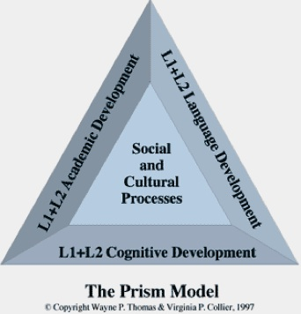
Their Cultures
Notes:
Text p. 10-11 PRISM Model!!
The CLD Student: Asset or Liability (pp. 7-9)
Sociocultural Challeges (pp. 12-23)
Will continue in class on day 2.

Slide 21




How to include ELs in the classroom community
www
www.colorincolorado.org
Notes:
Back to Weebly.

Slide 22
How do ESL teachers know all of those languages?
We don’t!
The Linguistic Dimension
Notes:
Text pp. 65-74.

Slide 23
Current Theories of Language Development
Focus on language and its use, not just on linguistic components (move away from focus on grammar and translation)
Learning is more important than teaching!
Learning is maximized when it matches the processes that take place naturally in the brain.
Thematic integration across content areas unifies the language processes (reading, writing, speaking, listening). Emphasis should be on higher-order thinking skills.
(Diaz-Rico & Weed, 2006)
Notes:
Bullet 2--what the student learns is the important outcome of the teaching-learning process. NOT what the teacher teaches.
Diaz, Rico, and Weed: The Crosscultural, Language, and Academic Development Handbook: A Complete K-12 Reference Guide (4th Edition)

Slide 24
Krashen’s Monitor Model
People acquire second-language structures in a predictable order only if:
  Comprehensible input is obtained
  Anxiety is low enough to allow input into their minds

Slide 25

Krashen’s Monitor Model
The Input Hypothesis
  Language is acquired not by focusing on form but by understanding messages
  Language must contain comprehensible input
  Learners acquire a language by “intaking” and understanding language that is a “little beyond” their current level of competence (Krashen, 1981)
  New information should build off prior knowledge
  (i + 1)
  Scaffolding as a modification
Notes:
i + 1 --i is the current level of the acquirer’s competence; 1 is the next structure due to be acquired in the natural order
See p. 16 Hill & Flynn

Slide 26
Krashen’s Monitor Model
Affective Filter Hypothesis
  Learning a new language requires public practice
  Anxiety, embarrassment, or anger can block the learner’s ability to process new or difficult words
  The classroom environment should be engaging, non-threatening, and affirming of a child’s native language and culture

Slide 27

Jim Cummins
Cognitive approach to language
  Learners are not “empty vessels” but come with knowledge of the world
Common underlying proficiency (CUP)
  Second language and primary language have a shared foundation
  Competence in the primary language provided the basis for competence in the second language

Slide 28
Jim Cummins
Distinction between two types of language
  Basic Interpersonal Communication Skills (BICS)
  Cognitive Academic Language Proficiency (CALP)

Slide 29

But they sound like they know English!
BICS vs. CALP
Teachers should not assume that ELLs who have acquired a high level of fluency in social language (BICS), have a similar degree of academic language proficiency (CALP).

Slide 30
Basic Interpersonal Communication Skills
Cognitive/Academic Language Proficiency
BICS | CALP
Social language 2-3 years Context embedded | Academic language 4-5 years Context reduced
Follows general directions Converses easily about social situations with peers and teachers May decode reading material with ease but may struggle with comprehension Can find and copy the answers to questions in textbooks | Can follow specific directions for academic tasks Expresses reasons for opinions and asks for clarifications Reads academic materials with good comprehension Can write essays supporting a point of view
Notes:
Jim Cummins identified two categories of language proficiency:
Basic Interpersonal Communication Skills: BICS
Cognitive/Academic Language Proficiency: CALP

Slide 31
Linguistic Processes of Second Language Acquisition (SLA)
Each stage has specific characteristics
that indicate the progress of the
English language learner along the
continuum towards English language
proficiency.
Notes:
After the slide, say:
We’ll give an overview of each of the five stages.
We’ll look at the student characteristics and offer some appropriate prompts to use to engage the students at each of the language proficiency levels.
We’ve also included approximate time frames for each of the stages of language acquisition.
HOWEVER, those time frames, based on earlier research, reflect how long it WAS taking for SLA. Since then, we’ve learned more about effective strategies for ELLs.
Research shows that Quality Instruction can accelerate the pace of learning.

Slide 32
Stages of Second Language Acquisition (SLA) (Adapted from Krashen and Terrell)
Stage | Characteristics | Approx. time frame | Teacher Prompts
Entering Level 1 Preproduction | “Silent Period” Minimal comprehension Nods, Draws, Points | 0-6 months | Show me… Circle the…? Where is…? Who has…?
Emerging Level 2 Early Production | Limited comprehension Produces one- or two-word responses Participates using key words and phrases | 6 months-1 year | Yes/No questions Either /Or questions Lists Labels
Developing Level 3 Speech Emergence | Good comprehension Produces simple sentences Makes grammar and pronunciation errors | 1-3 years | Why…? How…? Explain… Phrase or short-sentence answers
Expanding Level 4 Intermediate Fluency | Excellent comprehension Makes few grammatical errors | 3-5 years | What would happen if…? Why do you think…?
Bridging Level 5 Advanced Fluency | The student has a near-native level of speech. | 5-7 years | Decide if… Retell…
Notes:
See text pp. 75-81.
Back to Weebly

Slide 33
ACCESS Language Proficiency Test
Overall Score
Speaking
Listening
Reading
Writing
Notes:
ACCESS is given in January. The ESL staff gives the test in schools with an ESL program, often with the assistance of the counselor and ESL Resource Teacher. In schools without the ESL program, the counselor gives the test.
Scores are given for 4 Domains:
SPEAKING, LISTENING, READING, WRITING,
plus an OVERALL/COMPOSITE Score.

Slide 34
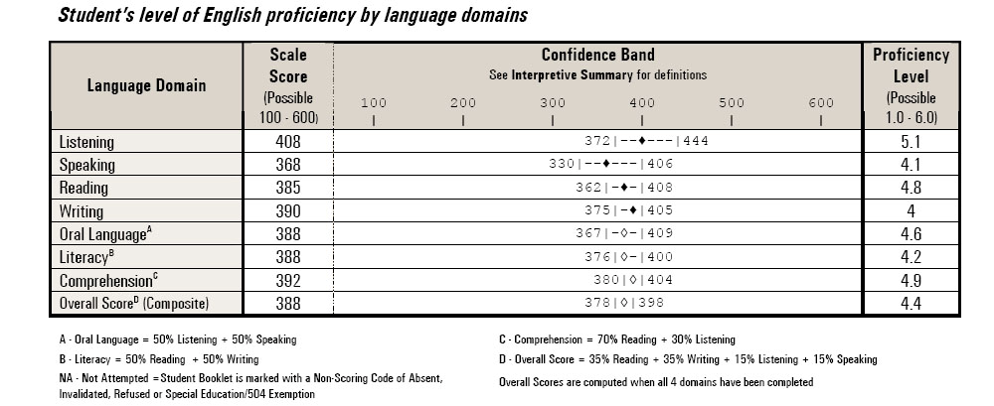
ACCESS Teacher Reports
You can also access this information on Infinite Campus.
Notes:
This report gives information about the student’s progress in the 4 domains: Speaking, Listening, Reading & Writing.
It also gives an overall composite score, and a literacy score.
These scores provide us with important data about instructional and assessment accommodations our students need.

Slide 35
ACCESS Language Proficiency Levels
 |  |  |  |  | REACHING 6.0
 |  |  |  | BRIDGING 5.0 – 5.9
 |  |  | EXPANDING 4.0 - 4.9
 |  | DEVELOPING 3.0 - 3.9
 | EMERGING 2.0 – 2.9
ENTERING 1.0 – 1.9
Notes:
ACCESS Can-Do Descriptors give you an idea of what students typically can do at each level of proficiency.

Slide 36

ACCESS SCORES for EXITING ESL
5.0
or higher
4.0
or higher
COMPOSITE SCORE
LITERACY SCORE
EXIT ESL PROGRAM
Notes:
You might be wondering:
How does a student go from LEP to RFEP?
Here’s the exit criteria.
The Literacy Score is derived from the reading and writing scores.

Slide 37
Cooperation versus Competition
Many cultures emphasize cooperation over competition.
A classroom structured to maximize learning through cooperation can help students extend their cultural predilection for interdependence. (Diaz-Rico & Weed, 2006)
Notes:
We are going to be using various interaction strategies that are effective for English learners during our class. Why should we learn about these.
Bullet 1-culturally responsive teaching.

Slide 38
Why Cooperative Learning Promotes Language Learning
We Learn by Speaking
  Traditional classroom: Student speaks less than 2 minutes/hour
  Cooperative classroom: Student speaks 30 minutes/hour
Lower Anxiety
  Traditional classroom: Large group of strangers
  Cooperative classroom: Small group of friends

Slide 39
Why Cooperative Learning Promotes Language Learning
Language Use= Language Acquisition
  Traditional classroom: Formal, decontextualized
  Cooperative classroom: Language in natural context
Peer Support
  Traditional classroom: Negative interdependence (based on competition)
  Cooperative classroom: Positive interdependence (based on cooperation)

Slide 40
Interaction
Frequent opportunities for interactions and/or discussion between teacher/student and among students that encourage elaborated responses about lesson concepts
Grouping configurations support language and content objectives of the lesson
Sufficient wait time for student response
Ample opportunities for students to clarify key concepts in L1 as needed with aide, peer, or L1 text
Notes:
Discuss last three bullets here. First one is on next slide.

Slide 41
Interaction
Frequent opportunities for interactions and/or discussion between teacher/student and among students that encourage elaborated responses about lesson concepts
Livebinder
Numbered Heads Together
Three-Step Interview (Think-Pair-Share)
Send a Problem
Four Corners (Building Background)
Jigsaw
Notes:
LiveBinder
Why it works:
We learn by speaking.
Lower anxiety = greater language acquisition.
Language in natural context (MAKE CALP MORE LIKE BICS)
The group needs and supports each member’s efforts at communication.
5. Students work together to negotiate meaning.
Pages 2-5 Interaction section of SIOP binder.

Slide 42

Range of Program Models for CLD Students
Jigsaw
English as a Second Language (ESL)
Transitional Bilingual Education
Developmental Bilingual Education
Two-Way Immersion
Notes:
Jigsaw with Combination Notes

Slide 43
Summarizing and Note Taking (Marzano)
Review/Assessment (SIOP)
Four main generalizations can be drawn from the research on note taking:
  Verbatim note taking is the least effective way to take notes.
  Notes should be considered a work in progress.
  Notes should be used as study guides for tests.
  The more notes taken, the better.
(Marzano, 2001)

Slide 44

Summarizing and Note Taking (Marzano)
Review/Assessment (SIOP)
Note Taking for ELs
  Give students teacher-prepared notes.
  Teach students a variety of note-taking formats.
  Use combination notes.
(Hill & Flynn, 2006)
Notes:
Provides a model. Clear example. ELLs also need pictures.As students progress, notes can be given with some words missing.
Model all forms with clear, concise explanations. Infomal outline, webbing (great for ELLs), and combination.
Linguistic and nonlinguistic forms. Very helpful for ELLs because include visuals.
Handouts with examples.

Slide 45
Jigsaw Task
Number off from 1-4
Ones read about English as a Second Language (text pp. 115-118).
Twos read about Transitional Bilingual Education (text pp. 118-120).
Threes read about Developmental Bilingual Education (text pp. 120-122).
Fours read about Two-Way Immersion (text pp. 123-125).
2. All groups be prepared to share the following about the assigned program model:
Foundations
Characteristics
Essentials and Concerns

Slide 46
Jigsaw Task
Groups will come back together with a 1, 2, 3, and 4 in each group.
Each group member will share with the others about his/her assigned program model.
Each group member will take notes using combination notes.

