Slide 1
Sheltered Instruction
“Effective models of ESL programming (e.g., CALLA [Chamot & O’Malley, 1994]) typically emphasize frequent opportunities for language interaction, the scaffolding of instruction, and constructivist activities focused on the derivation of meaning from context, language, and support structures (Echevarria & Graves, 2003; Linquanti, 1999; Ovando, Combs, & Collier, 2006).”
Notes:
Text p. 116
While we are limited to the program model for which we have resources, we are not limited to how effective we can strive to make this program model for kids!!!

Slide 2
Sheltered Instruction
“A focus on language interactions typically involves frequent and sometimes extended opportunities for teacher-student and student-student communication at all literacy levels: listening, speaking, reading, and writing.”
Notes:
Text p. 116

Slide 3
CALLA
Review the Chamot & O’Malley article using Shaping Up summarizing strategy.
Developed to help English learners (ELs) prepare to participate in content-area instruction in the mainstream classroom
Can be used in ESL, bilingual, and general education classrooms
3 components
Curriculum correlated with mainstream content subjects
Academic language development activities
Learning strategy instruction

Slide 4
CALLA
English learners were performing well on English proficiency assessments, but they were having severe difficulties when mainstreamed into the regular classroom.
Assessments weren’t measuring academic English attainment.
Academic language skills lag behind the development of social skills by 5-7 years.
CALLA was designed to be a bridge to the mainstream, taught by ESL professionals.
Notes:
CALLA can be used in ESL, bilingual, or mainstream classrooms.

Slide 5
Knowing how to perform certain activities
Factual knowledge
Information a person knows

Slide 6
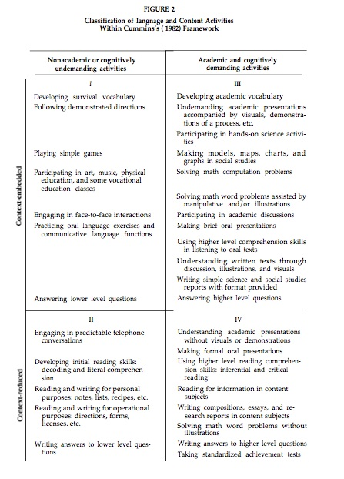
Notes:
See text p. 42

