Slide 1
Comprehension
By: Ashley & Chrissy

Slide 2
Skills to Know
Summarizing
Sequencing
Inferencing
Comparing and Contrasting
Drawing conclusions
Self-questioning
Problem-Solving
Relating background knowledge
Distinguishing between fact and opinion
Finding Main Idea, important facts, and supporting details

Slide 3
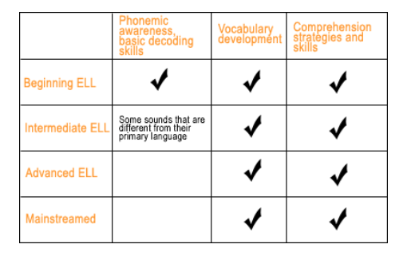
Why reading skills are particularly important for ELLs…

Slide 4
Barriers/ Challenges
May read slowly
Hard time picking out important events, characters, etc.
Easily frustrated
Overall content areas

Slide 5
Strategies to build comprehension
Build background knowledge through multiple exposures
Comprehension Check (open- ended questions)
Questioning ( B-M-E, Literal/ Inferential)

Slide 6
Video Findings
Guarded Vocabulary – activate background knowledge, introduce new words, introduce comprehension strategy (Making Inference)
Cooperative Learning – Talking partners, repeated, questions,
Visual – Anchor Chart, Big Book/ Wordless Book, Hand gestures
Hands-On Activities – **** They could have written their favorite part, drawn a picture, written a summary, etc.
Scaffold strategy: I Do, We Do, You Do – Gradual Release

