Slide 1
Building Background through Effective Vocabulary Instruction
Mary Morgan
JCPS ESL Elementary Resource Teacher
Notes:
Building Background is an instructional accommodation on the PSP.

Slide 2
Learning Targets
I can explain why vocabulary learning is important for my students.
I can identify grade-level KCAS standards that address vocabulary.
I can identify vocabulary words my students need to know in the content areas.
I can use an effective process for teaching vocabulary, including a note-taking scaffold and a vocabulary notebook.

Slide 3
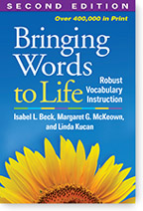
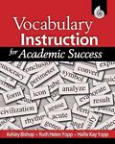
Some Helpful Resources
Vocabulary Instruction for Academic Success by Yopp, Yopp, and Bishop
Bringing Words to Life: Robust Vocabulary Instruction by Beck, McKeown, and Kucan
Literacy Instruction for English Language Learners by Cloud, Genesee, and Hamayan

Slide 4
Some Helpful Resources
Notes:
This recent practice guide recommends that teachers of ELLs:
Teach a set of academic vocabulary words intensively across several days using a variety of instructional activities.
-Choose from a small set of academic vocabulary for in-depth instruction.
-Use multiple modalities (writing, speaking, listening).
-Teach word-learning strategies.

Slide 5
Why Teach Vocabulary?
Learning is dependent on vocabulary knowledge.
Vocabulary knowledge is highly correlated with overall reading achievement.
Vocabulary knowledge affects a student’s ability to participate fully in both social and academic activities.
The vocabulary gap is likely to be larger for English language learners than for native English speaking students.
It is a requirement of the Kentucky Core Academic Standards.
Notes:
(First 4 points are also taken from KY Reading First Summer Institute 2005.) Notice that vocabulary instruction is part of the KCAS standards. It is state law that we teach vocabulary. (Reading Informational CCR4, Language CCR4, 5, 6)

Slide 6
Notes:
Building Background is an instructional accommodation on the Program Services Plan for ELLs. Effective vocabulary instruction is one way of building background.

Slide 7
Reading Informational CCR4
Interpret words and phrases as they are used in a text, including determining technical, connotative, and figurative meanings, and analyze how specific word choices shape meaning or tone.
Language
CCR4
Determine or clarify the meaning of unknown and multiple-meaning words and phrases by using context clues, analyzing meaningful word parts, and consulting general and reference materials, as appropriate.
Language
CCR5
Demonstrate understanding of word relationships and nuances in word meanings.
Language
CCR6
Acquire and use accurately grade-appropriate and domain-specific words and phrases, including those that signal precise actions, emotions, or states of being and that are basic to a particular topic.
Notes:
These are the standards students need to master by the end of grade 12. What do they look like at your grade level? (Share KCAS progressions for these two anchor standards.) What do you notice about the language vocabulary standard? (Students need to learn how to use roots and affixes to further their vocabulary understanding. This is best practice for ELLs.)
Word Learning Strategies (students independently learn new word meanings when they learn to use word learning strategies such as exploring context and anaylzing prefixes: (Edwards, Font, Baumann, & Boland, 2004; Graves, 2000)-part of a comprehensive vocabulary program that also includes Direct Teaching of Important Individual Words (Beck, McKeown, & Kucan, 2002). Feldman and Kinsella

Slide 8
RI.CCR.4
Anchor
Interpret words and phrases as they are used in a text, including determining technical, connotative, and figurative meanings, and analyze how specific word choices shape comprehension.
K
With prompting and support, ask and answer questions about unknown words in a text.
1
Ask and answer questions to help determine or clarify the meaning of words and phrases in a text.
2
3
4
5
Determine the meaning of words and phrases in a text relevant to a grade 2 topic or subject area.
Determine the meaning of general academic and domain-specific words and phrases in a text relevant to a grade 3 topic or subject area.
Determine the meaning of general academic and domain-specific words and phrases in a text relevant to a grade 4 topic or subject area.
Determine the meaning of general academic and domain-specific words and phrases in a text relevant to a grade 5 topic or subject area.
Notes:
Here is an example of what one KCAS standard that addresses vocabulary, RI.CCR.4, looks like in a progression from K-5. What do you notice about how the language changes across the progressions? How could you use this for an ELL?

Slide 9
Research reveals that vocabulary knowledge...
is related to a student’s ability to ________ text
comprehend
is related to overall __________ success.
academic
is related to higher status ___________.
occupations
influences peoples’ judgment of __________.
the speaker
is influenced by __________.
instruction
Yopp, Yopp & Bishop, 2009
Notes:
Let’s see what other researchers says about vocabulary.
If time allows, participants can turn and talk to complete these statements.

Slide 10
Vocabulary Acquisition
At age 5-6 children typically have 2,500-5,000 words in their oral vocabulary.
3,000 words per year are added during their early school years.
A large amount of vocabulary growth is incidental.
Vocabulary development is a primary factor in second language acquisition and the academic success of ELL students.
Notes:
This slide and the next one represent well-known research. They can be skipped if not enough time.
Here is some research on vocabulary acquisition.
Consider the bullets on the slide.
(Cue Bullet 1)
The first bullet has the word typically. Think about your classroom...are your students typical?
(Cue Bullet 2)
What do you think the next bullet implies? (that we must expose kids to vocabulary and teach vocabulary)
(Cue Bullet 3)
What about bullet three, if a large amount is incidental, how is the rest acquired? (through directly teaching vocabulary)
(Cue Bullet 4)
Here again we have the word typical. Is this indicative of your classroom?
(Many teachers think vocabulary instruction involves targeting 10-20 words per week. This method alone will not maximize vocabulary acquisition. Students also need extensive experiences with language and strategies they can use independently to learn word meanings.)
Children develop the vast majority of their speaking vocabulary through listening to and speaking with others not by being taught words one at a time.
(Cue Bullet 5)
How is vocabulary instruction for ELL students addressed in your classroom?
Limited vocabulary is a major contributor to low standardized English test scores. (August & Shanahan, 2006)
The opportunity to use oral language is especially critical for vocabulary development of ELL students.
Between the ages of two and six, children learn an average of 6-10 new words per day. ELL children are learning those words in their native language, not English.

Slide 11
Why Students Struggle With Vocabulary
For ELL
students this
exposure
is usually
NOT in English.
(Hart & Risley, 1995) | Words Heard per Hour | Words Heard in a 100-Hour Week | Words Heard in a 5200-Hour Year | Words Heard in 4 Years
Group A | 616 | 62,000 | 3 million | 13 million
Group B | 1,251 | 125,000 | 6 million | 26 million
Group C | 2,153 | 215,000 | 11 million | 45 million
Notes:
Take a moment to reflect upon your understanding of this slide. Make connections to your school population. What can you conclude based upon this research? (Group A-Welfare, Group B-Working Class, Group C-Professionals)
ELLs are most likely in groups A and B. This is an even larger challenge!
THIS IS NOT A SOCIO-ECONOMIC ISSUE ALONE! There are other circumstances in addition to this information that influence vocabulary acquisition for ELL students.
These students especially need frequent opportunities to use oral language in the classroom. Research shows that they have little opportunity to converse. (Au, 2000; Toohey, 1998)
Reflect/discuss with whole group. Vocabulary development is important for all of our students!
By age 4, the gap in words heard increases to 32 million.

Slide 12
What We Know
Vocabulary instruction is effective when…
key words are directly taught using strategies to make them clear.
students are repeatedly exposed to and given opportunities to use vocabulary words they are taught.
words to be taught are carefully and intentionally selected to help with comprehension.
Notes:
It is especially important to give ELLs the opportunity to talk about domain-specific and general academic vocabulary. (IES Practice Guide from slide 20-recommendation 2).

Slide 13
What Doesn’t Work
Assigning words for students to look up in a dictionary.
Expecting students to figure out the meaning of a new word using context.
Depending on spontaneous explanations.
Why?
Why?
Why?
Notes:
Teachers turn and talk to share why they think each of these strategies is difficult for students. While each of them can help students expand their vocabulary understanding, they shouldn’t be used as the main instructional strategy for teaching students vocabulary. (Narrowing the Language Gap: The Case for Explicit Vocabulary Instruction by Feldman & Kinsella, 2005)

Slide 14
Selecting Vocabulary Words
What words should I teach?
Notes:
Practice Guide Recommendation 1 is hyperlinked. Participants will need a handout of pages 16-17. Read p. 16 & top of p. 17. Turn to a partner. What did you learn about choosing vocabulary words to teach? Could you make a handout to help teachers with selecting vocabulary based on what you read?
Starting with the assessment can also help here.

Slide 15
Selecting Vocabulary Words
Notes:
Beck, McKeown, Kucan (2002)
Tiers have different terminology depending on the reference.

Slide 16
Tier 1: Common, Known Words
Tier 1 words are basic ______________ words that are part of most children’s ______________. These words are used every day in __________, and most of them are learned by hearing __________, peers, and teachers use them when ______________. These words are especially _____________ for English learners who may not be _______________ with them.
Examples: big, small, house, table, family
Notes:
Cloze-HO Print cloze slides as handouts for participants to try to complete. Do this with a partner.
Answers: everyday, vocabulary, conversation, family, speaking, important, familiar
Examples: big, small, house, table, family

Slide 17
Word Bank
familiar, conversation, everyday, family, vocabulary, important, speaking
Does the addition of a word bank help you complete this task?
Notes:
A word bank can provide an important scaffold for ELLs!
Answers: everyday, vocabulary, conversation, family, speaking, important, familiar

Slide 18
Tier 3: Low-Frequency, Domain-Specific Words
Tier 3 words are low-____________ words that that may be __________to specific _____________ of instruction and do not have _____________ application for students.
Examples: isotope, tectonic plates, mitosis
Notes:
Answers-Frequency, limited, domains, broad
Isotope, tectonic plates, mitosis

Slide 19
Word Bank
Does the addition of a word bank help you complete the task?
limited, broad, frequency, domainsimited, broad, frequency,, domains
Notes:
Answers-Frequency, limited, domains, broad

Slide 20
Tier 2: High-Frequency Words (aka Cross-Curricular Vocabulary)
Tier 2 words include ______________ occurring words that appear in various contexts and ____________ and play an important ________ in listening and _____________ comprehension across a variety of ____________ areas. These are general ____________ words and they have ____________ utility.
Examples: justify, explain, maintain, coincidence, absurd, fortunate
Notes:
Answers-Frequently, topics, role, reading, content, academic, high
Examples: Justify, explain, maintain, coincidence, absurd, fortunate

Slide 21
Word Bank
high, content, role, frequently, topics, reading, academic
Does the addition of a word bank help you complete this task?
Notes:
Answers-Frequently, topics, role, reading, content, academic, high

Slide 22
Examples of Tier 2 and Tier 3 Words in Context
Read Appendix A, pages 113-115 from your KCAS binder.
Turn to a partner and discuss these questions:
What is the difference between tier 2 and tier 3 words?
Which words do you think your students need to focus on?
Notes:
HO pp. 113-115 from appendix A KCAS E/LA binder. Teachers read and share with an elbow partner. One partner shares with the whole group.
You must PREVIEW the text to be taught and identify vocabulary or sentence structures that are new for the students.
You must KNOW your students! 6-10 words is recommended for ELs (Cloud, Gennessee, and Hamayan p. 136)
You have to know what type of ASSESSMENT students will be taking to demonstrate their learning.

Slide 23
Examining Words from Texts
Before reading check for:
Tier 2 words
Your English learners also might need help with
Multiple meaning words (e.g., table, set, odd)
Cognates
Idioms

Slide 24
What are cognates?
Cognates are words in two language that share similar meaning, spelling, and pronunciation.
http://m.spanishcognates.org/cognate-list/j
Can you name the English cognates for these words?
Notes:
Be careful of false cognates. A cognate that isn’t already known by the student in the L1 will not be helpful in learning the word in English.
http://www.colorincolorado.org/educators/background/cognates/

Slide 25
You probably already know some cognates!
Familia (Spanish)
Family
Clase (Spanish)
Class
Splendide (French)
Splendid
Simplificar (Portuguese)
To simplify

Slide 26
How will you know which words to teach?
Vocabulary Knowledge Scale
Word | I don’t remember ever seeing or hearing this word. | I have seen and/or heard this word but don’t know what it means. | I have seen and/or heard this word and I think it means… | I know this word. It means… | I can use this word in a sentence:
Notes:
HO-The VKS
Try this with some Tier 2 words from Intellivocab SAT practice app words:
Abdicate- to give up (royal power or the like)
Daring-brave
Edify-to build up, or strengthen, especially in morals or religion
Jocose-done or made in jest (THIS IS THE WORD THAT WILL BE USED AS AN EXAMPLE LATER.)

Slide 27
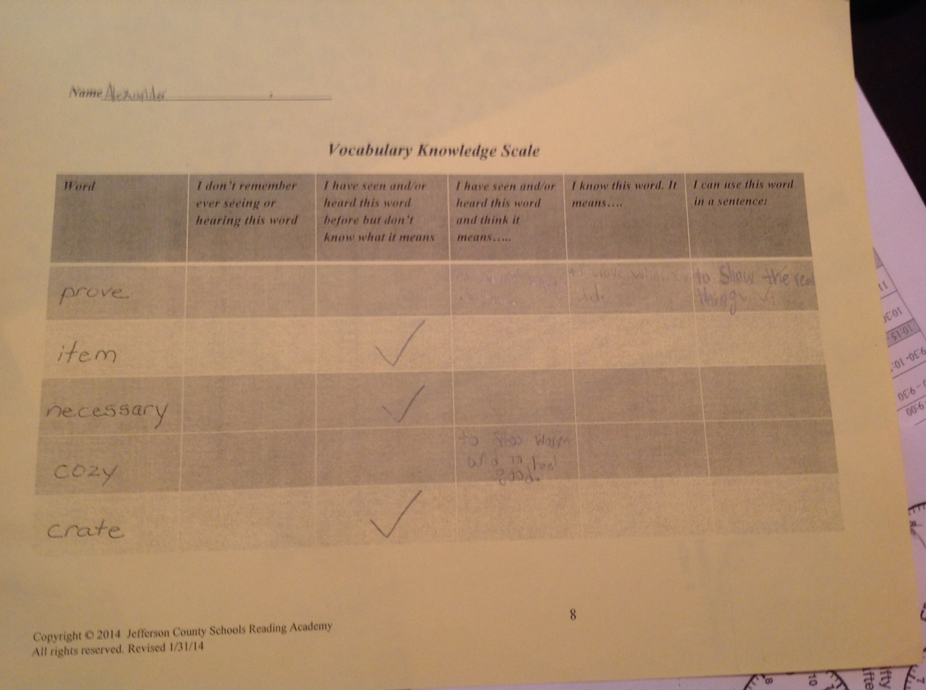
Notes:
A VKS by an ELL.
Prove-to show the real thing
Cozy-to stay warm and feel good

Slide 28
How do I teach the words so the students will learn them?
Marzano’s Six-Step Process for Vocabulary Teaching
Notes:
Marzano’s 6-step process is well-known. What makes it effective?

Slide 29
Research on Effectiveness of Marzano’s Vocabulary Teaching Strategy (Marzano, 2009)
It’s how someone uses the strategy that determines whether it produces great results, mediocre results, or no results at all (p. 83).
When students copy the teacher’s explanation or description of a term instead of generating their own explanation, the results are not as strong. Student explanations should come from their own lives (p. 84).
Why would teachers sometimes not have students generate their own explanations? What are some alternate solutions?
Notes:
It’s important that the teacher use an explanation that students understand.

Slide 30
Research on Effectiveness of Marzano’s Vocabulary Teaching Strategy
The third step in the process is crucial. When students do this step well, achievement soars.
Why would teachers sometimes skip this step or have students copy a visual representation? What are some alternate solutions?
Games seem to engage students at a high level and have a powerful effect on students’ recall of the terms.
Why would teachers sometimes skip having students play games with the vocabulary words learned? What are some alternate solutions?
Notes:
For visuals, share example of America and lollipop!
Examples of simple activities that can be considered games will be shared in a moment.

Slide 31
Student-Friendly Explanations
Characterize the word and explain how it is regularly used.
Describe the meaning of the word in everyday language. Include words like something, someone, or describes. These words assist students in attending to the whole definition.
Notes:
It is a good idea to define and explain vocabulary words using student friendly explanations. I find it very helpful to associate the word with a term they already know.

Slide 32
Not All Definitions are the Same
Traditional Dictionary-
Delicacy
Delicate
A choice food.
The quality of or state of being delicate; fineness, weakness, sensitivity, etc.
Student-Friendly Definition
Something good to eat that is expensive or special: Snails are considered a delicate tidbit in France. (a delicacy)
A careful and sensitive way of speaking or behaving so that you do not upset anyone (=tact): He carried out his duties with great delicacy and understanding.
Notes:
This slide shows us how to change a dictionary definition into a student-friendly definition.
Quite often we ask students to look up words in dictionaries but research says not all definitions are the same.
This is one example of the difference between a traditional definition and a student-friendly definition.

Slide 33
Vocabulary Notebooks and Note-taking Scaffolds
A note-taking scaffold has many advantages (Marzano et al, 2001)
It provides an advance organizer of the most essential lesson terms.
It keeps students on-task and accountable during vocabulary teaching.
It provides a reference for later study and practice of new terms.

Slide 34
Notes:
HO -Simplified organizer for K and grade 1 (?) and ESL newcomers
For younger students. How can you use this to support vocabulary learning?
- Shrink and glue in notebook.
-Make copies and staple with a cover that shows the content and topic.
-Could your students reproduce this in their notebook? How would that work?
Teachers should have a large organizer all students can see and refer to.

Slide 36
Notes:
This is an organizer that an ESL teacher from Roosevelt Perry created for her newcomers and kinder students.

Slide 37
Notes:
For older students. This organizer supports word learning strategies that help students learn more words independently. Which KCAS standard does this support? (Language CCR 4)
Synonym and sentence can be used to expand understanding in step 4 of Marzano.

Slide 38
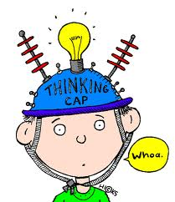
Let’s Do This!
Jocose
Notes:
The Haiku Deck link (Jocose) won’t open in Explorer!

Slide 39
How will you know when students have learned vocabulary that you directly teach?
Completed note-taking scaffold
Oral reading record
Student constructed responses-short answer and extended response
Teacher observation of when the child uses the word correctly
In peer discussion
In writing
During vocabulary review activities
Notes:
Example: When Holly Terry’s students used previously taught vocabulary (special) to describe a new vocabulary word (ordinary) when she said it means not special.

Slide 40
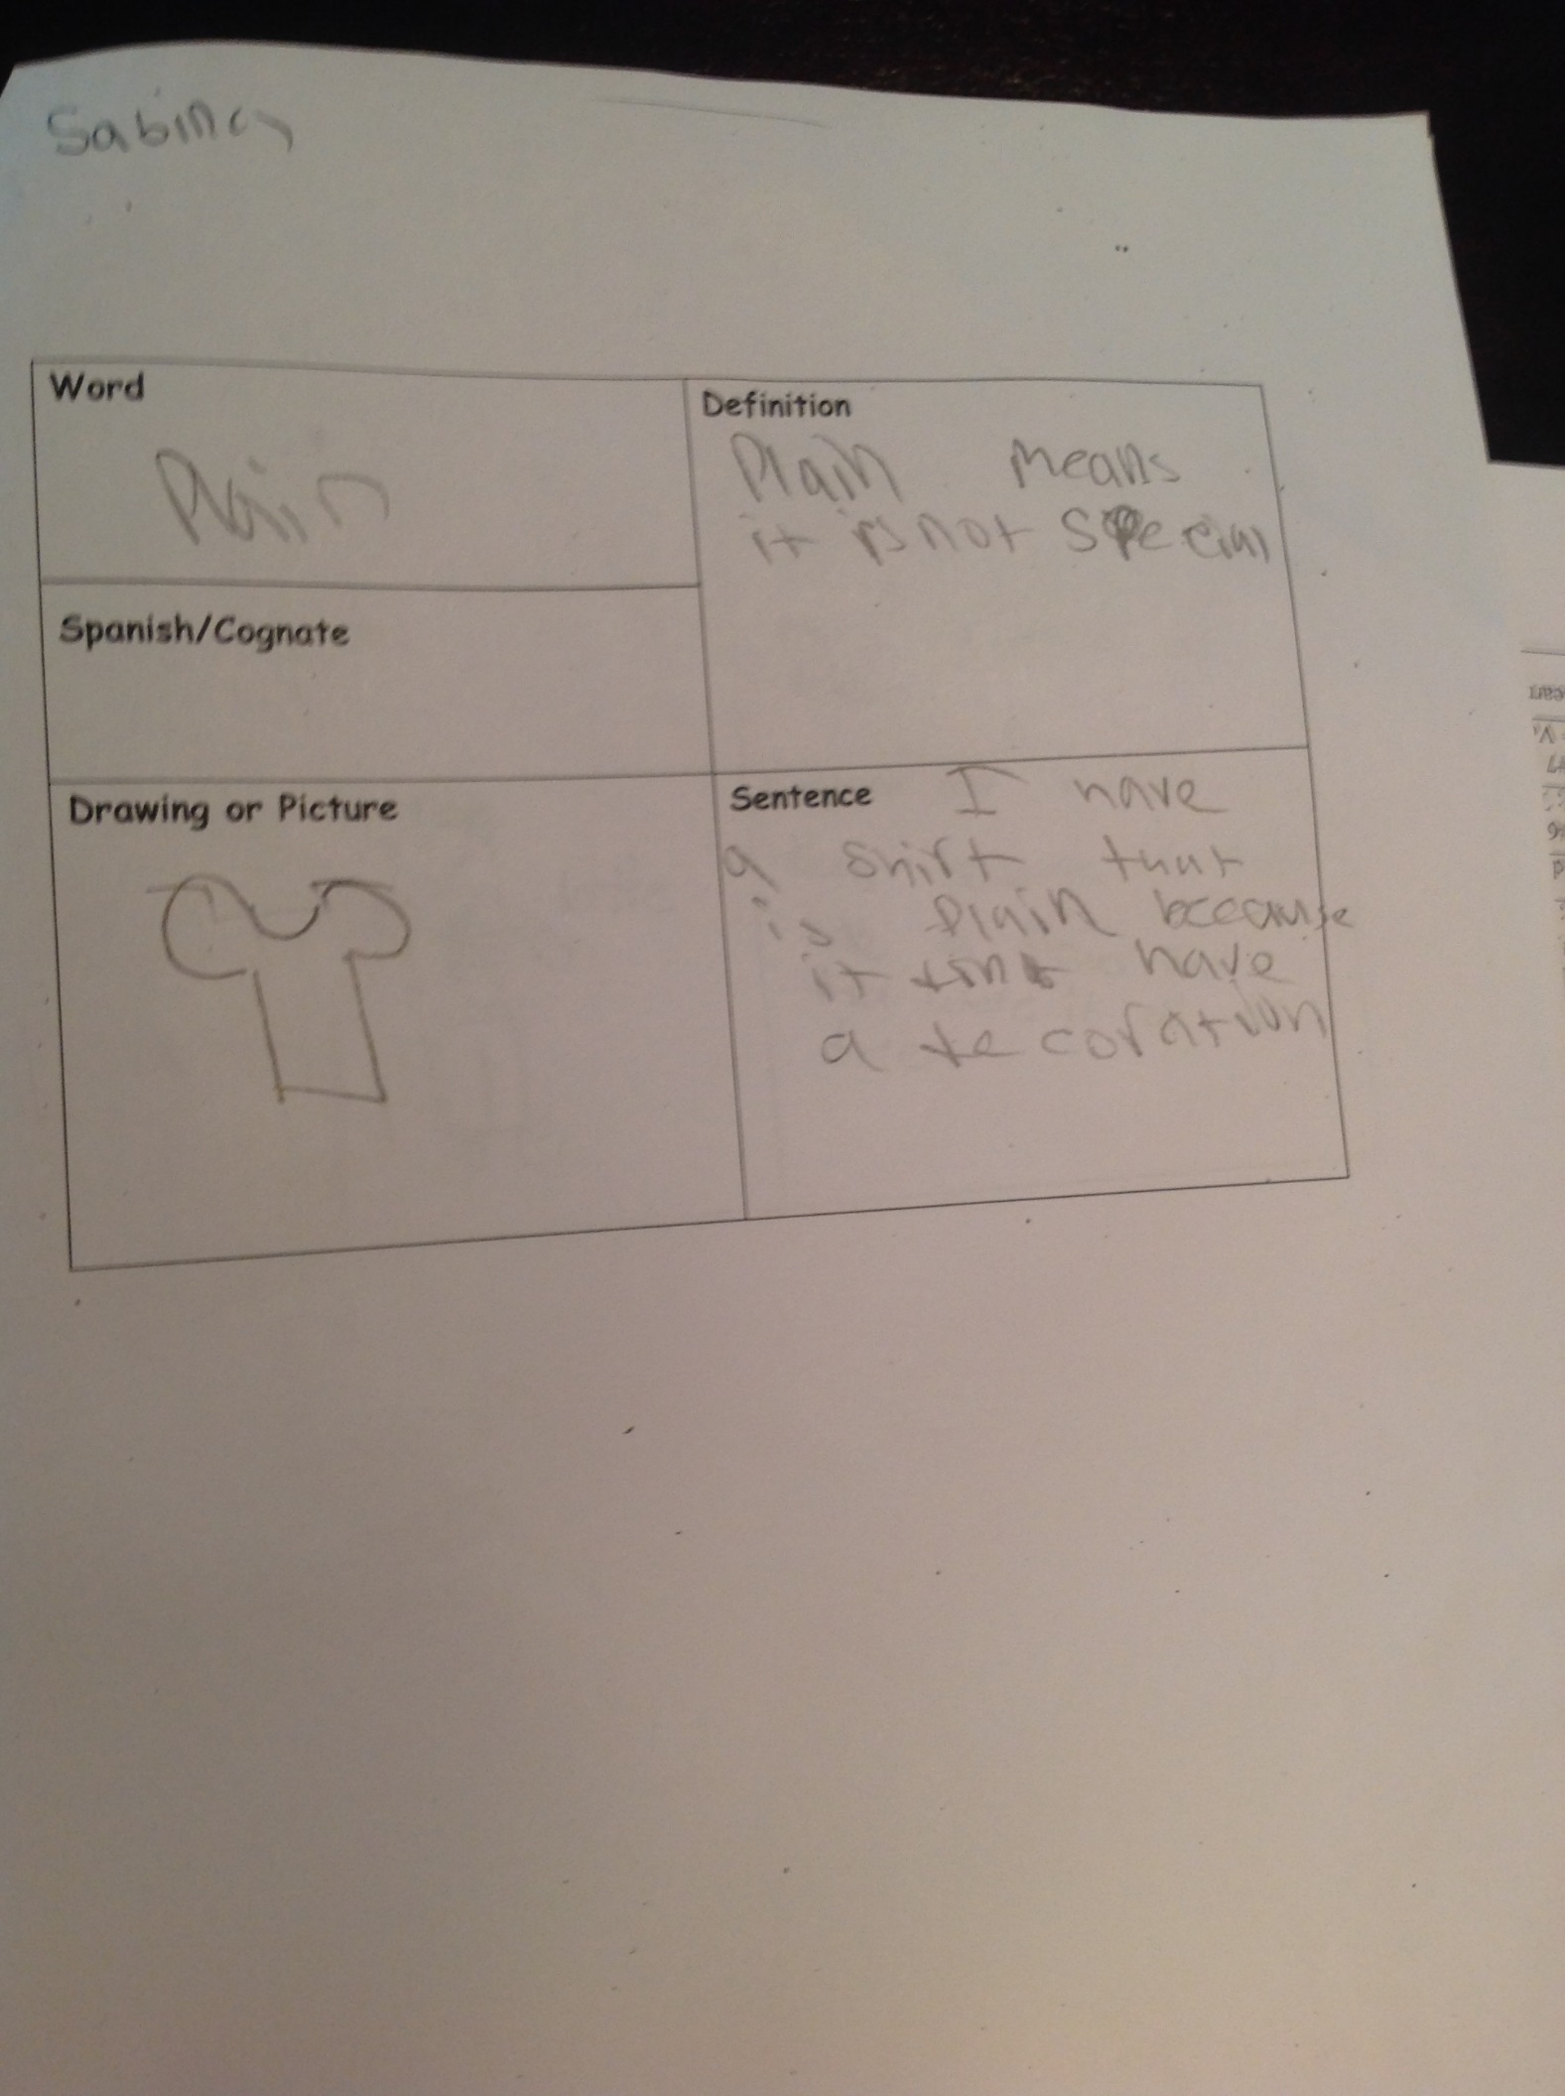
Notes:
The word special had been previously taught using this process. Obviously, the student understands that word as well as her new word, plain.

Slide 41
Resources and Professional Reading
Contemporary Classroom Vocabulary Assessment for Content Areas (Stahl & Bravo, 2010)
Six Steps to Better Vocabulary Instruction (Marzano, 2009)
Making Vocabulary Instruction Effective and Engaging (McKeown & Beck, 2011)

